Slide 1
Arts Integration: Student Materials and Rubrics

Slide 2
Brochure Storyboards
Students used this to format the information for their brochure promoting a place or thing.

Slide 3
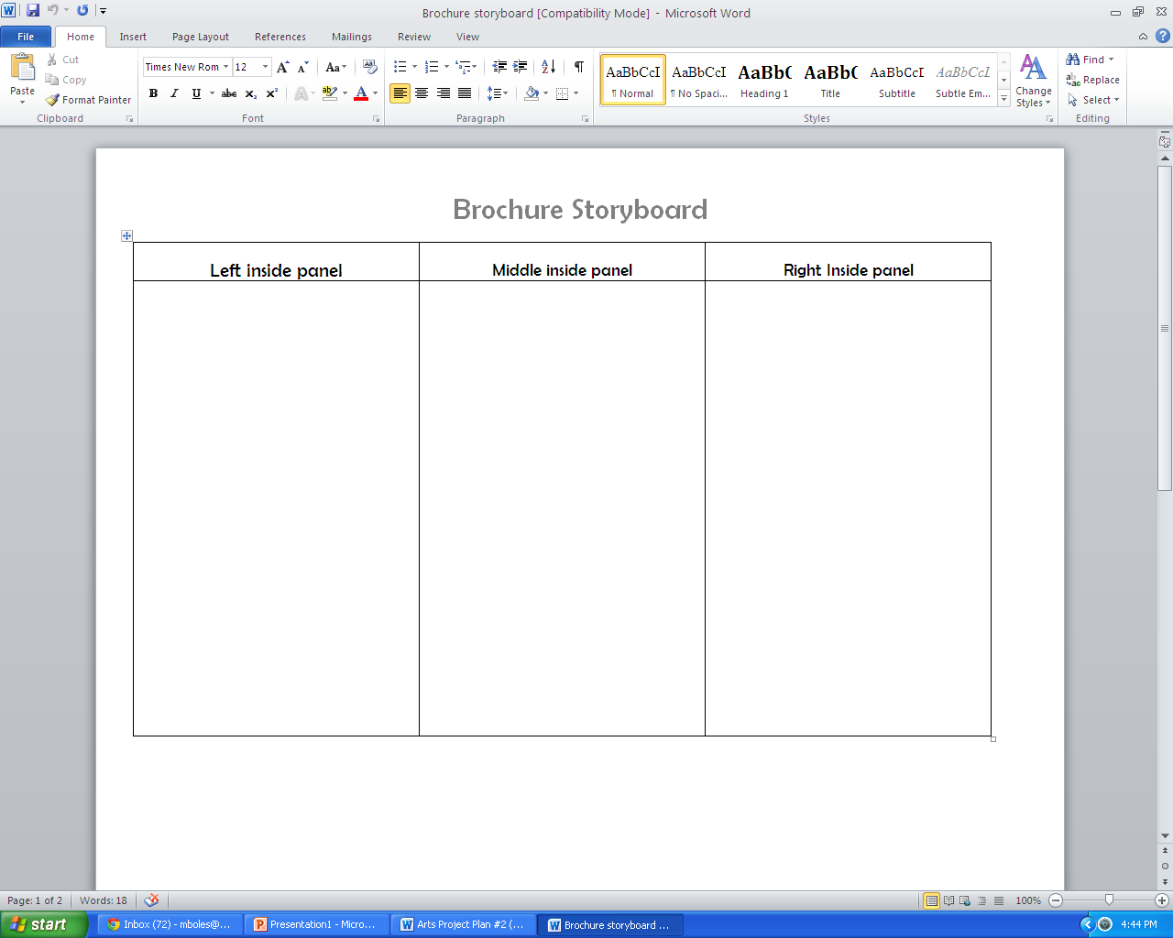

Slide 4
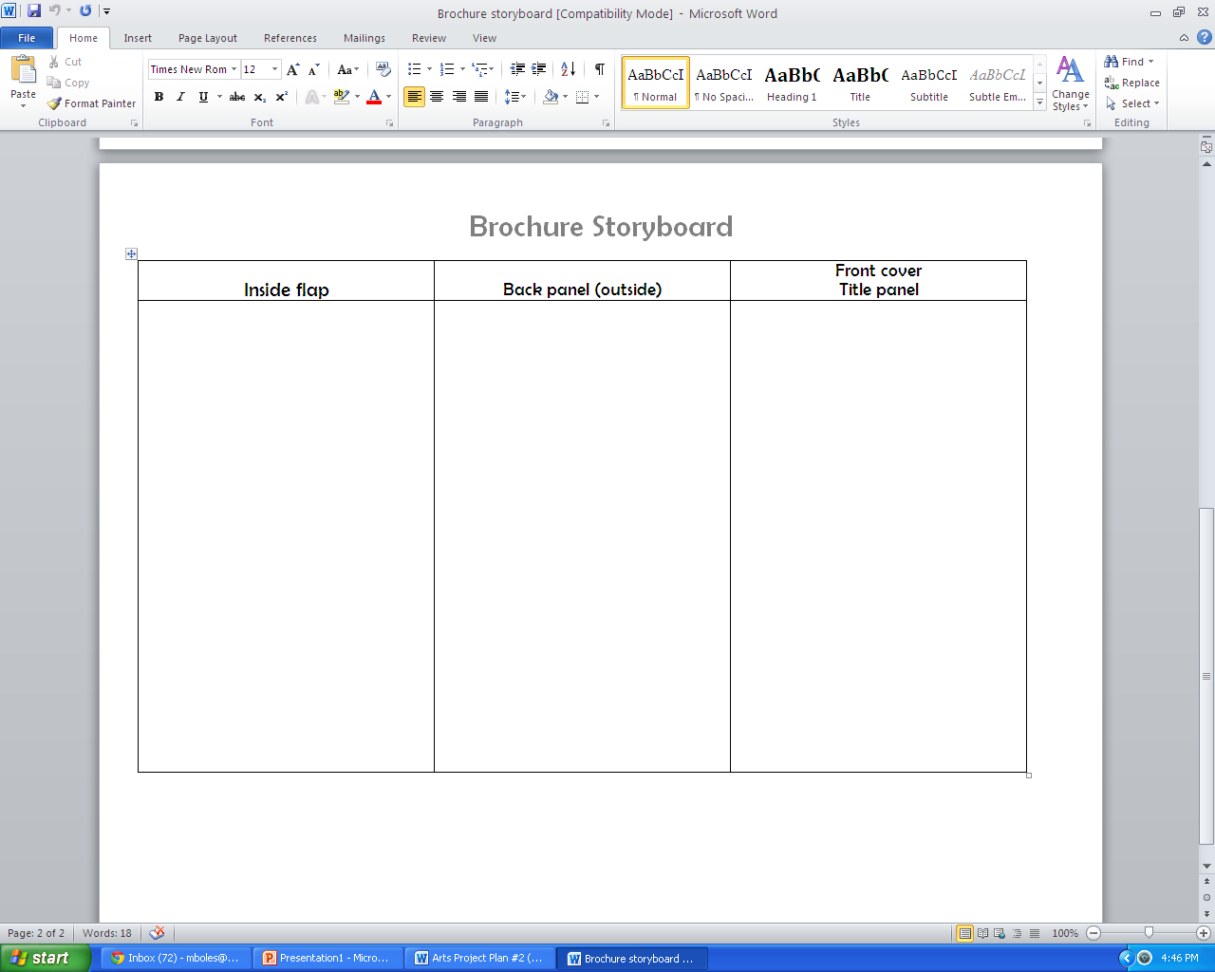

Slide 5
Dinner Party Choice Menu
Students planned a dinner party where they took on the role of a character from one of the stories we had read so far. They then held a the dinner party to demonstrate the character traits of the character they chose to portray.

Slide 6
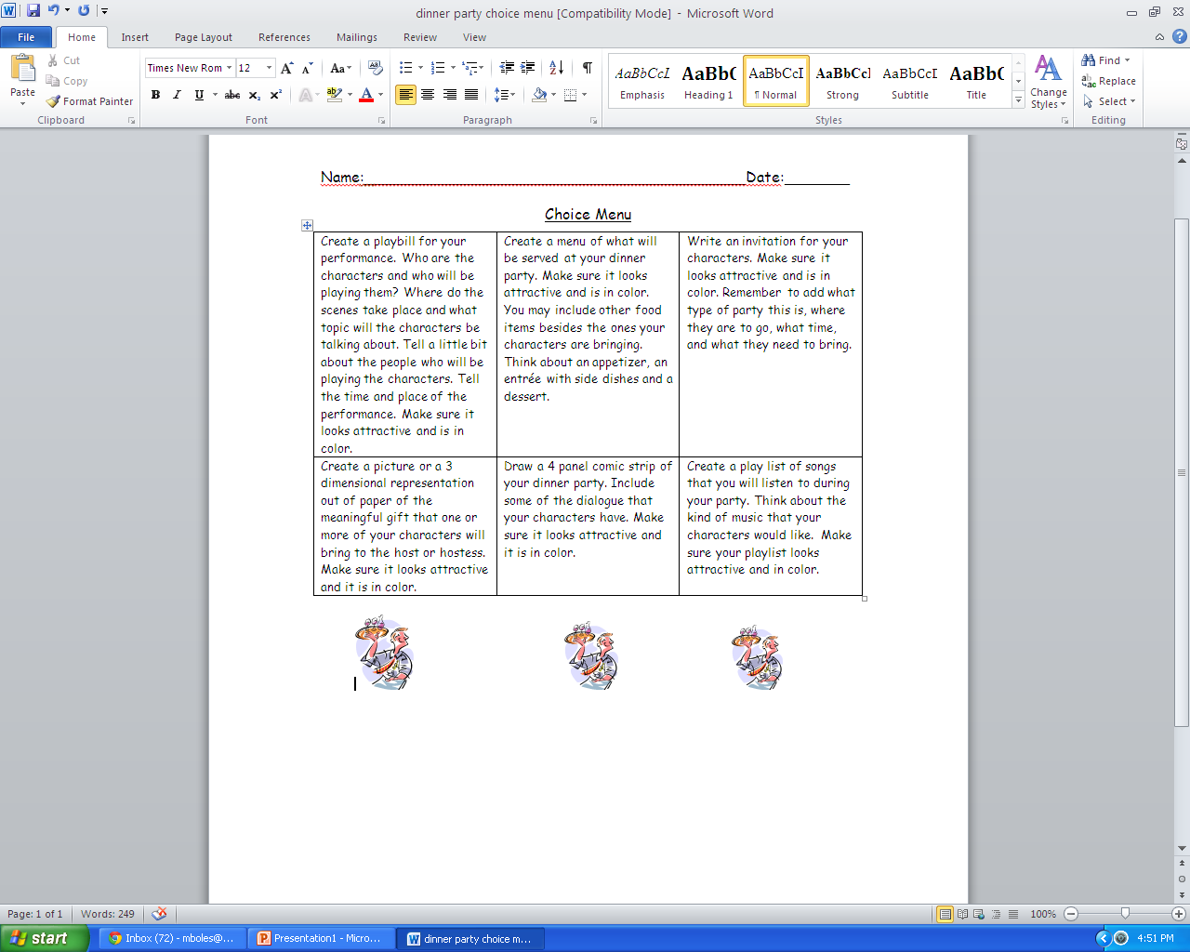

Slide 7
Dinner Party Character Matrix

Slide 8
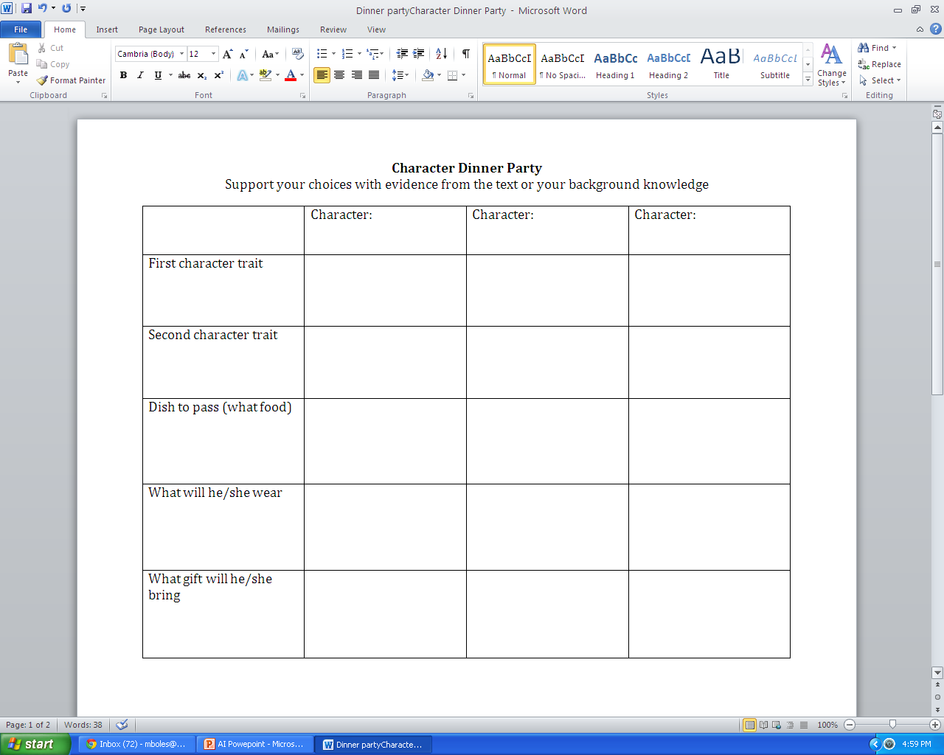

Slide 9
Dinner Party Character Survey

Slide 10
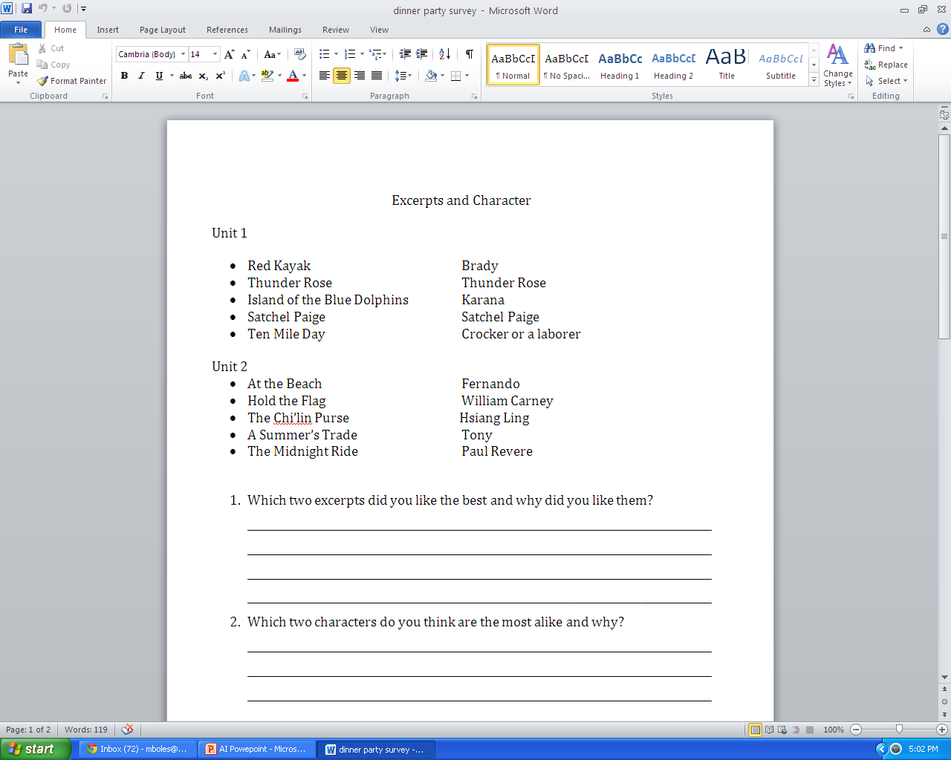

Slide 11
Dinner Party Rubric

Slide 12
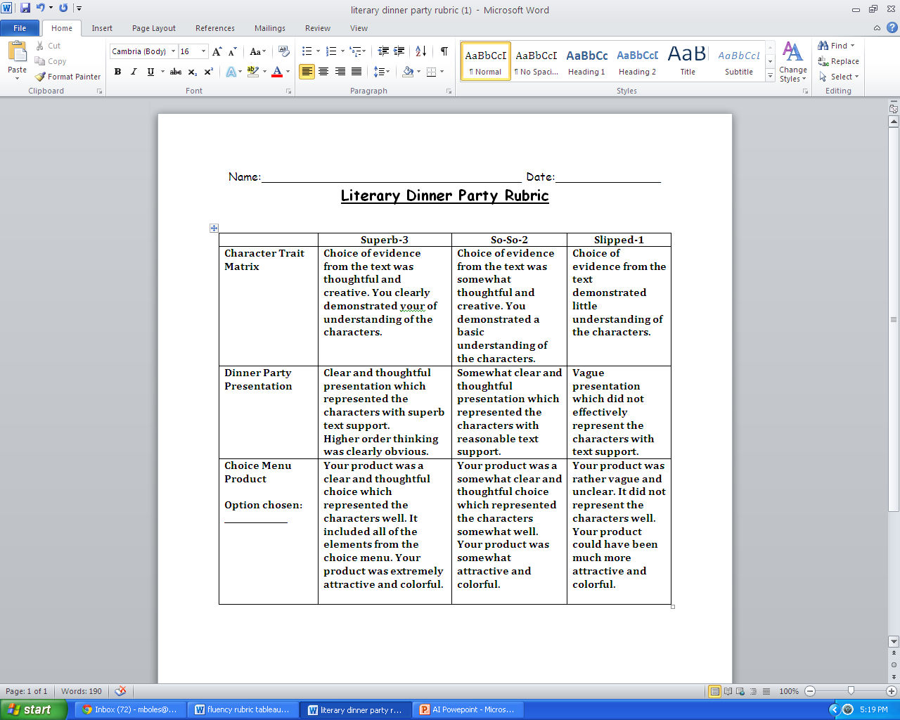

Slide 13
Tableau

Slide 14
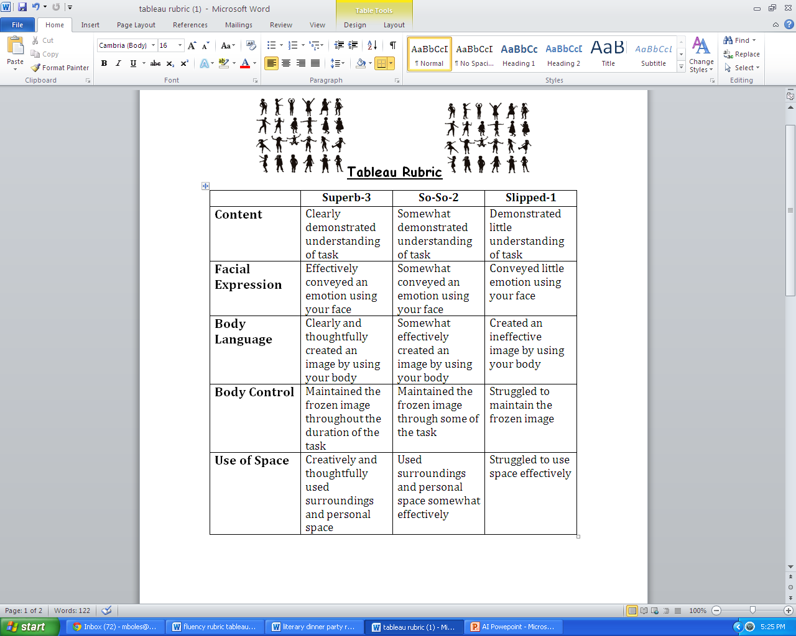

Slide 15
Tableau Narrator Fluency Rubric

Slide 16
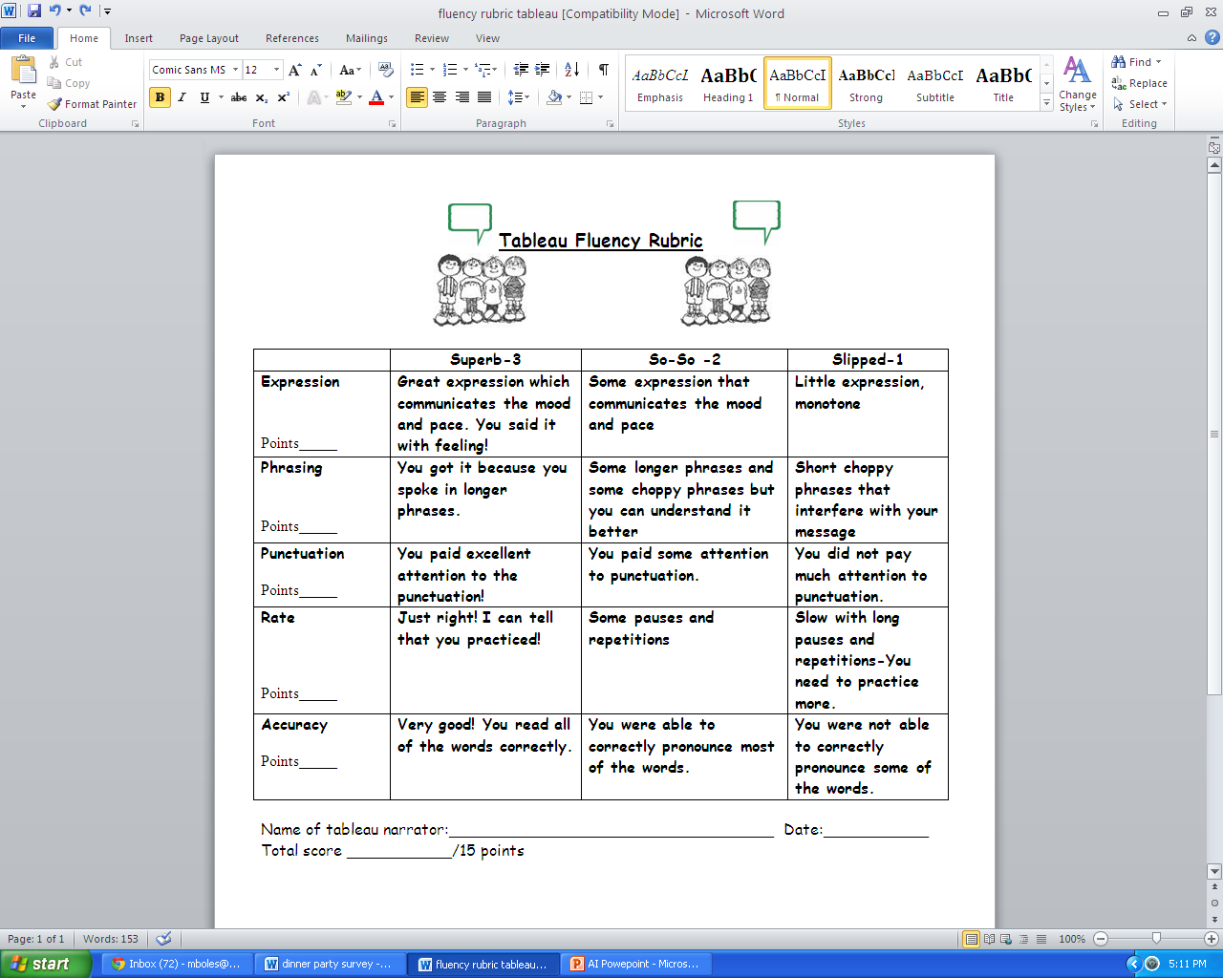

Slide 17
Silent Retelling -Weslandia

Slide 18
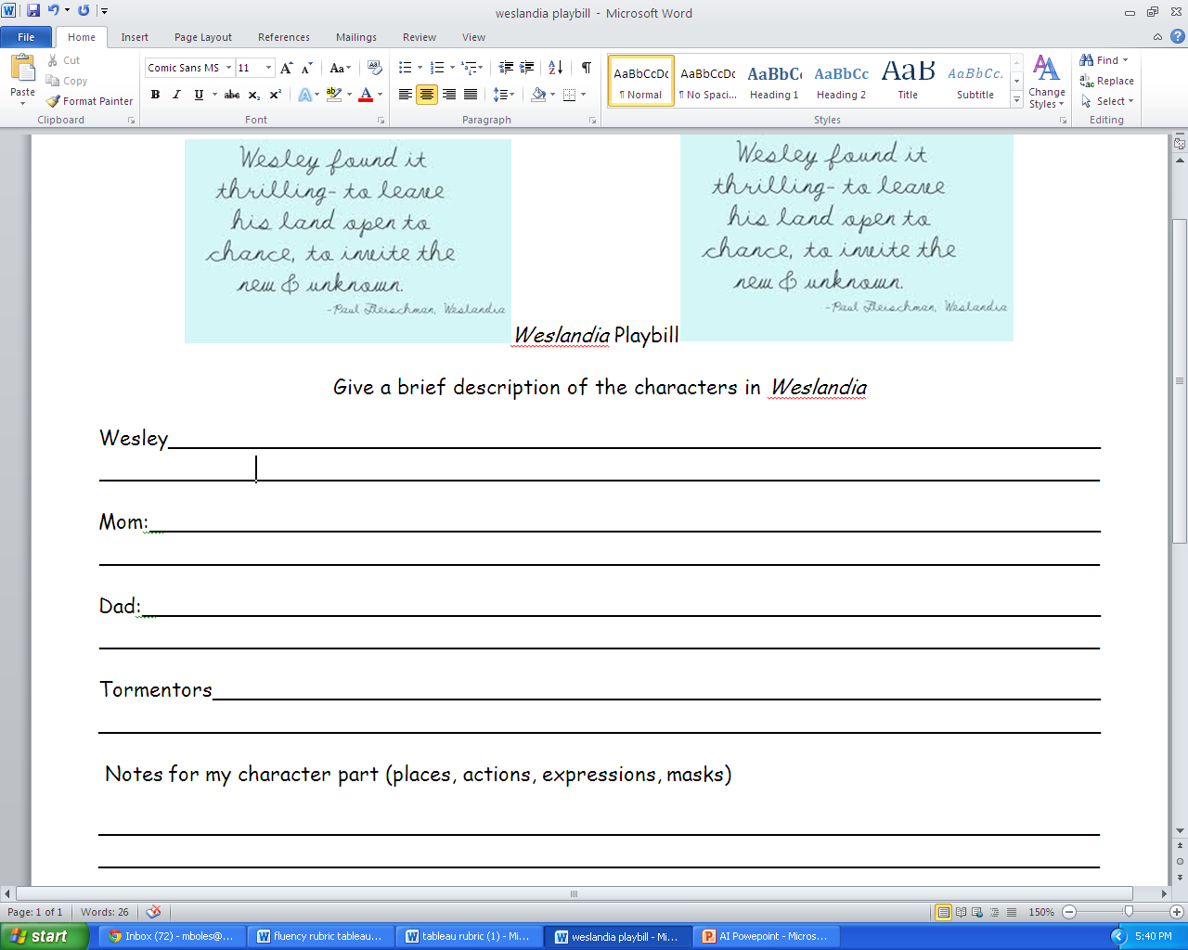

Slide 19
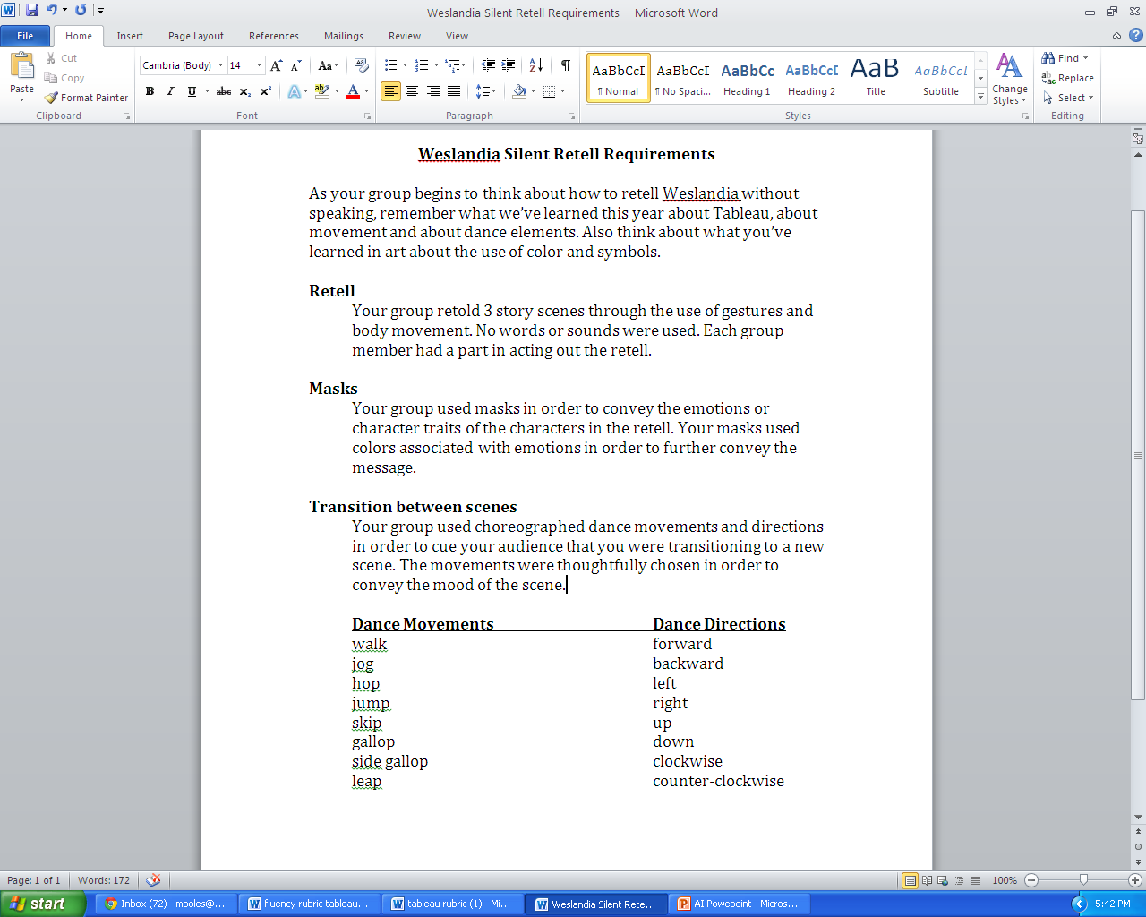

Slide 20
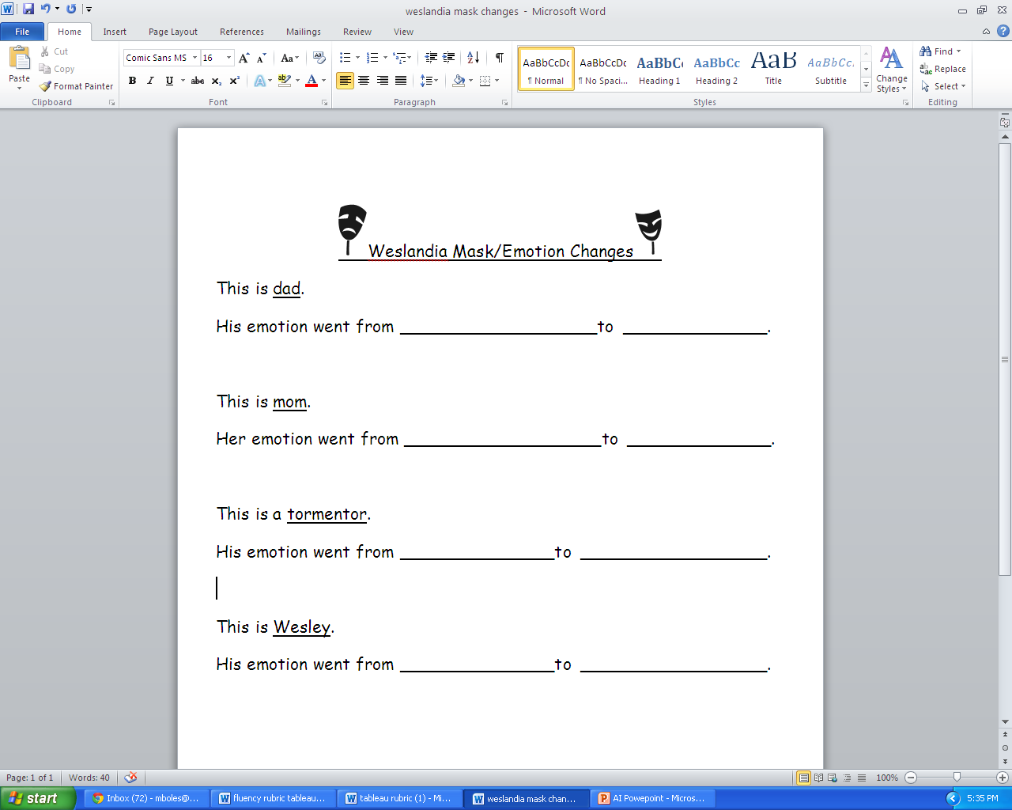

Slide 21
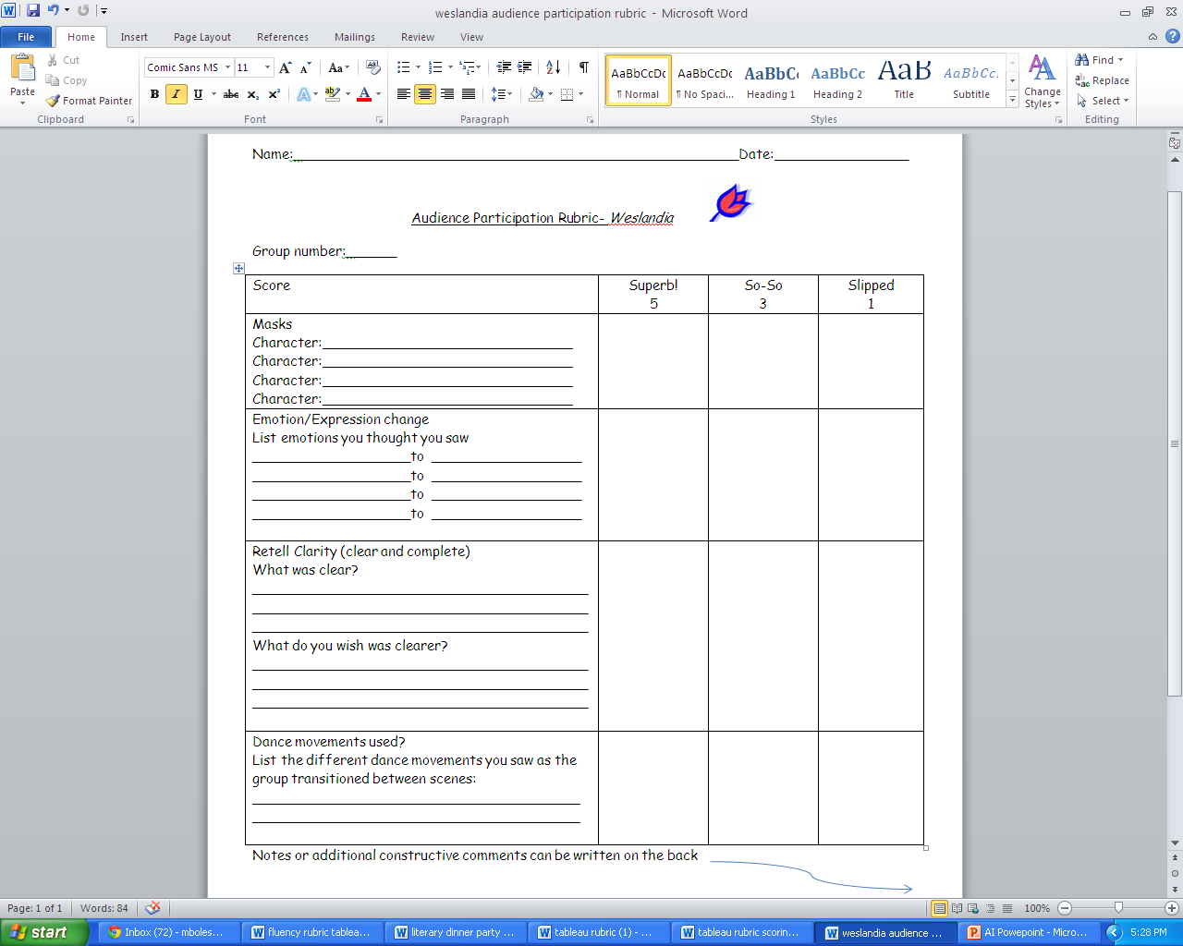

Slide 22
Materials designed for the 5th grade class of Mrs. Martell and Mrs. Boles

